Slide 1


Tourism management System
Software engineering project

Slide 2

Presentation by:
VISWANATH REDDY
(RA2011042010092)
P INDIVAR
(RA2011042010107)
SIGIRALA NAVEEN
(RA2011042010086)

Slide 3
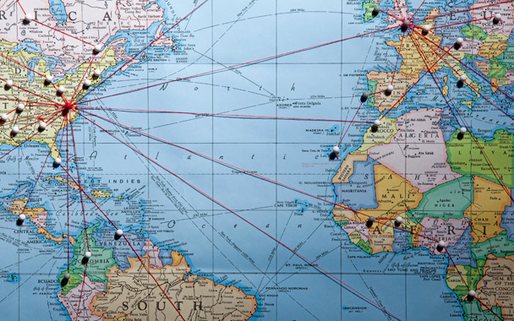
introduction
The Tourism management system is used to help people to find cheap and best tour packages for their travel. The booking system helps people/users to bypass the brokers who will charge people often when they book for their tour packages offline.

Slide 4

Tasks involved
Login and password management
Registration by users
Finding tour packages
Selecting cheap package
Booking tour package

Slide 5
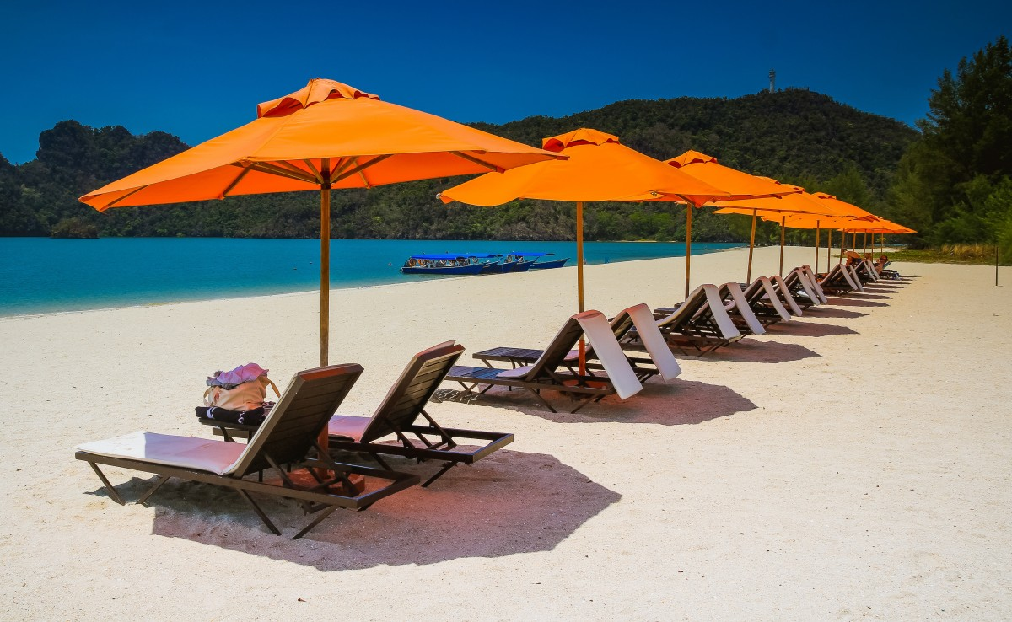
PROJECT AIMS AND OBJECTIVES
The project aims and objectives that will be achieved after completion of this project are presented in this slide. The aims and objectives are as follows:
• Online tour packages booking system
• An Admin login page where admin can add and manage tour packages
• Connecting customer directly to the agency

Slide 6
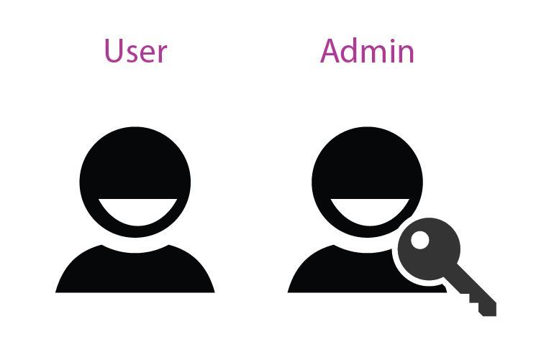
Modules
Customer module:
They can view different tour packages.
They can select the desired tour package, select the date of journey and book the package.
They can provide feedback in the comment section.
Admin module:
Has access to manage all the users and their bookings.
Can add or remove any tour packages at any time.

Slide 7

System requirements
Processor: Intel Core Processor / AMD Ryzen Processor
OS: Windows 7,8 and 10; UBUNTU and macOS
Memory: 8 GB RAM or more
Hard disk space: Minimum 3GB for Database for future
Database: MYSQL

Slide 8

DESCRIPTION OF INDIVIDUAL PHASE/MODULE
User characteristics:
Administrator
Customer
Travel Agency

Slide 9
PROBLEM ANALYSIS
Objectives:
Signup: New users give their email, and phone number for registration.
Login: The user enters their username and password for login.
Holiday packages: Users can then enter the date of journey and return; they can also select the packages.
Best deals: Users can get the best deals with discount prices based on their preferences available during the festival season.
Feedback: The users can give their input.
About us: The user can get information about the travel agency
Contact us: It displays the contact details.

Slide 10

Infrastructure
XAMPP – Used for local hosting the website
MYSQL- Database Management System
HTML & CSS- Used for designing the webpage and style of webpage

Slide 11
Functional Requirements
The customer must register for create the account and login using username and password to use function in the application
Collect data of customer personal information (name, email, tel number)
The customer can manage and see their profile.

Slide 12
Non-functional requirements
The Security of the System: Customers can access the system through registering and confirming in the system, and the customer cannot acquire any service information from the tourism information service system in the case of without the registration.
The Reliability of the System: Customers need a legitimate login system to accurately access to the travel information in the system.
The Portability and Scalability of the system: When a new customer appears, it can extend the function of the system on the basis of the original one and will not affect the existing function.
The Maintainability of the System: Ensure to solve the faults in the system within 24 hours

Slide 13
System testing
The aim of the system testing process is to determine all defects in the project. The program was subjected to a set of test inputs and various observations were made and based on these observations it will be decided whether the program behaves as expected or not. Our Project went through two levels of testing
1. Unit testing
2.integration testing

Slide 14
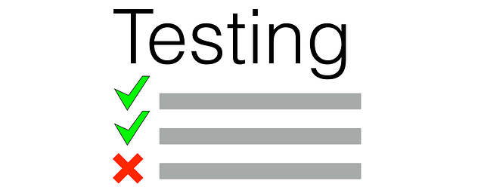
Unit testing
Test for admin module:
Testing of admin login page
Addition of users
Managing tour packages
Test for customer module:
Testing of customer signin form
Test for registration form

Slide 15

Integration testing
In this type of testing, we test various integrations of the project module by providing the input.
The primary objective of this testing is to test the module interfaces in order to ensure that no errors are occurring when one module invokes the other module.

Slide 16
CONCLUSION & FUTURE SCOPE
Tourism is currently recognized as a global industry that is growing at a high rate, like any other industry. This web-based application helps in maintaining the database. It has a friendly environment that connects customers willingly. Thus, it simplifies the process by saving our time and efforts. It will help tour managers to control and handle the tour-related activities effectively and efficiently. A further modification could be possible where the system can be integrated with bigger organizations such as tourist agencies in order to help them.

Slide 17
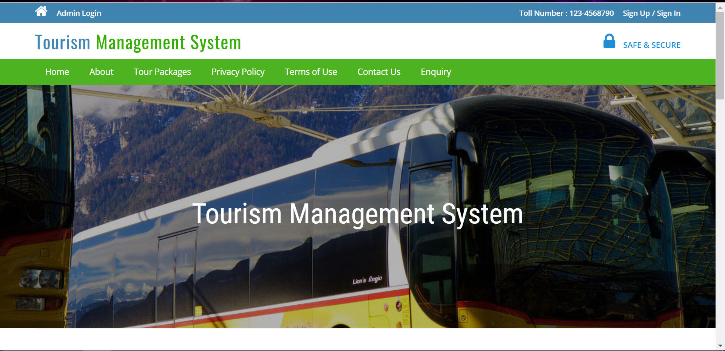
Screenshots

Slide 18
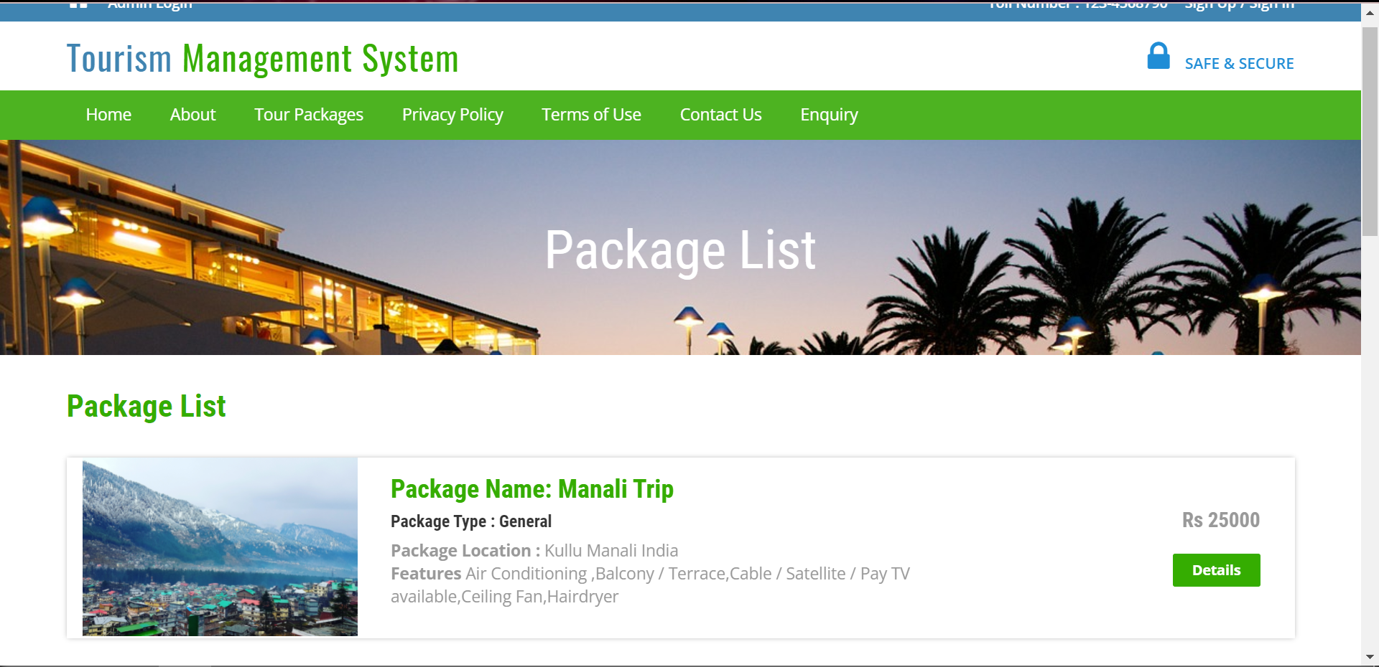
screenshots

Slide 19
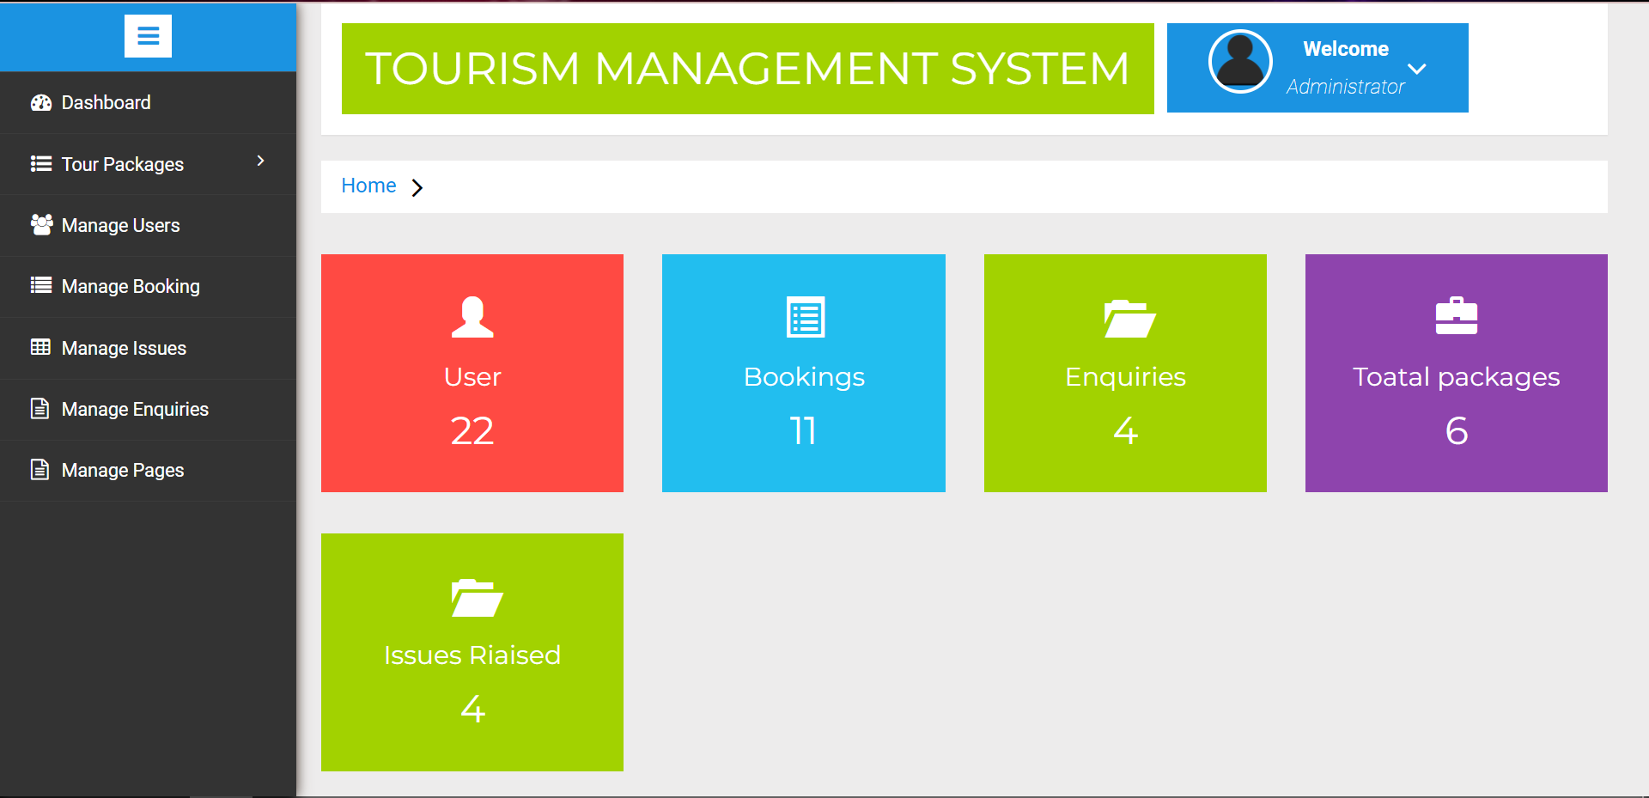
screenshots

Slide 20
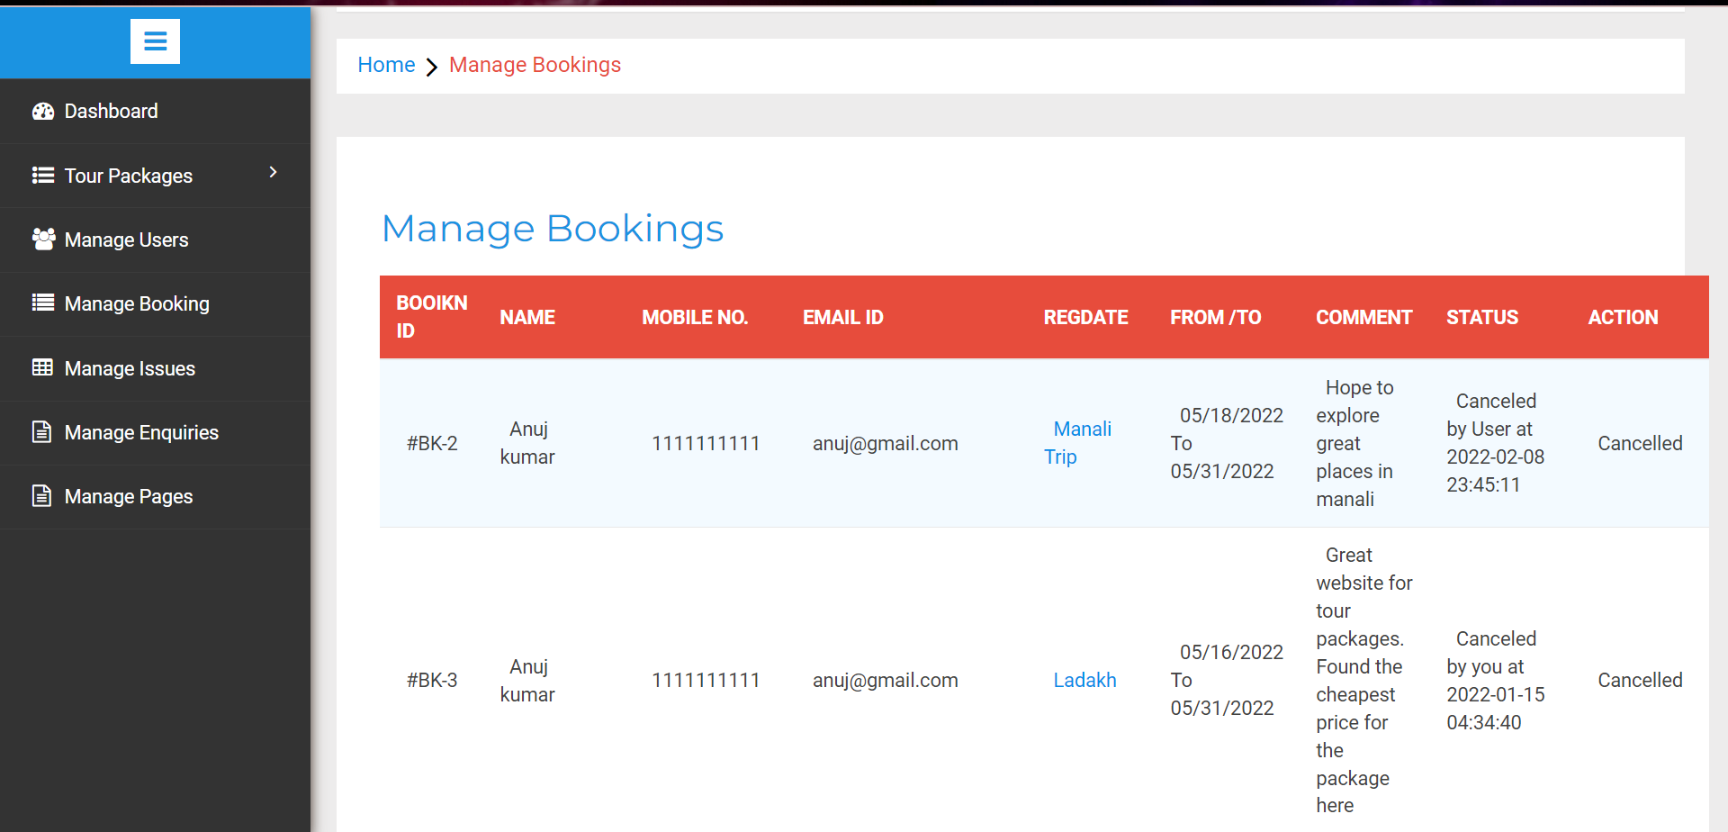
screenshots

Slide 21
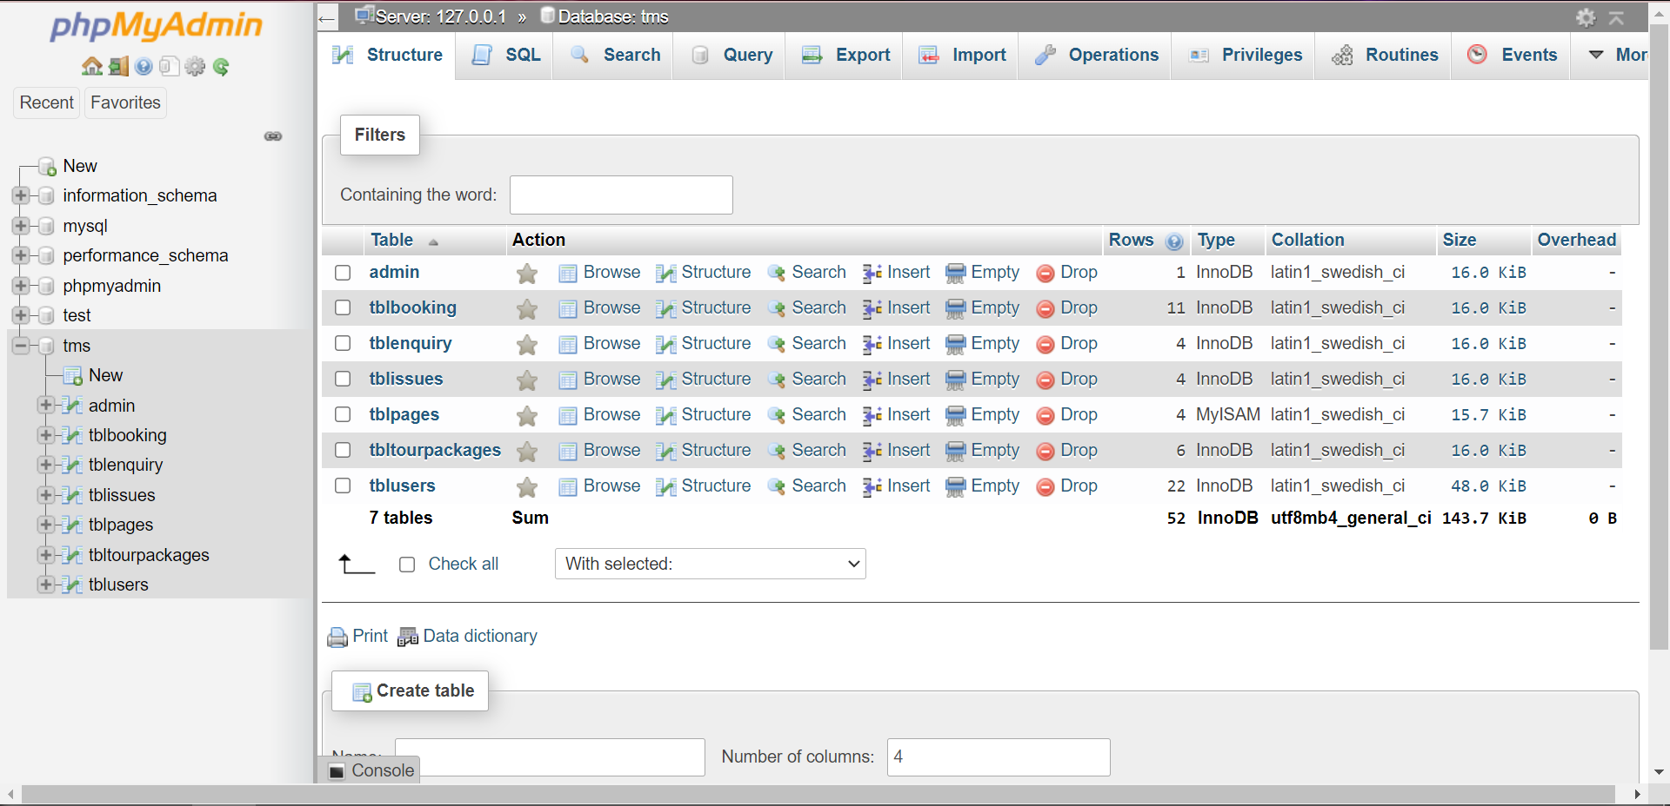
Screenshots

Slide 22


